Slide 1
Delay Discounting
Kendra Seaman
Postdoctoral Scholar
Fall 2018

Slide 2
Learning Objectives
Broad
Understand variability in human decision making processes
Tangible
Describe delay discounting
Compare delay discounting under various conditions
Create an experiment to study delay discounting and predict expected outcomes

Slide 3
Part 1
Access the short questionnaire and complete the test
Think about how much money you have right now. For each question, select the option that you’d rather have. Please choose as if you would actually get either the money tonight (the first option), or you’d actually get the money in the specified time (the second option)
https://tinyurl.com/y9usftyb
Notes:
Remind students to record their discounting score on the worksheet so that they can reference it later

Slide 4
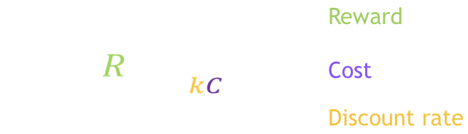
Delay discounting
Based on the activity you just completed how would you define delay discounting?
Delay discounting is the tendency to consider later rewards as less valuable (or discount later rewards)
Delay discounting is often associated with impulsivity, delayed gratification, self control
McClure, 2014
Notes:
Costs, like time delays, cause people to reduce, or discount, the value of an outcome. This graph shows the relationship between time delay, shown on the x-axis, and subjective value, shown on the y-axis. You can see as the time delay increases, the subjective value decreases. So for instance, after a month, $500 is worth only $450. After three years, $500 is only worth $200. Put another way, someone with this discount rate would be indifferent between receiving $200 now and receiving $500 in three years.
The rate at which people discount the value of an outcome is called the discount rate. We can use mathematical models to estimate the discount rate and examine how discount rates vary from person to person.

Slide 5
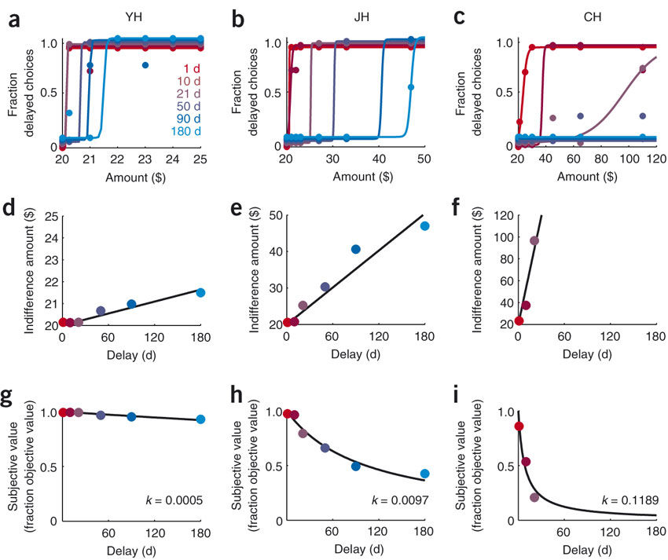
Modified from Kable & Glimcher, 2007
Notes:
For instance, three different people may have three different discount rates. Here, the man on the left is very patient and has a shallow discount rate. He would be willing to wait until after lunch for his coffee, wait until the end-of-year sales to buy the car, and happily invest in his retirement. However, the man on the right is very impatient and has a steep discount rate. He’s probably already sipping his coffee on his way to the beach in his new car! Thus, discount rates are an important individual difference we can examine.
One question is whether these individual differences persist as people get older. Do individuals have the same discount rate throughout their lives, or does aging cause people to be more or less likely to discount? I will explore this question in the two studies I am presenting here today.

Slide 6
Part 1 - Brainstorm
Think/Pair/Share - What individual factors may impact discounting/how?
Notes:
Age, drug history, personality traits

Slide 7
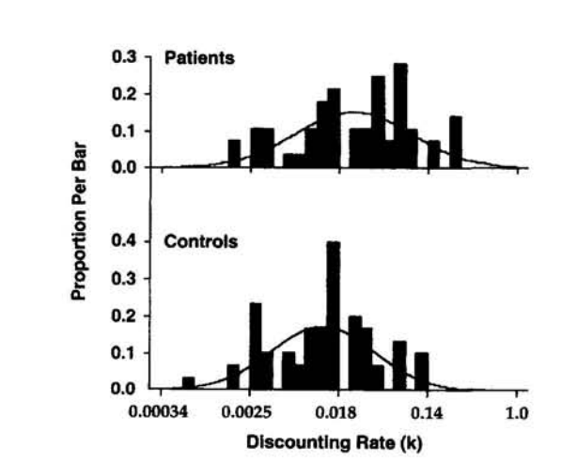
Addictive disorders
Individuals with addictive disorders tend to discount more than healthy controls (Amlung et al., 2017)
Degree of discounting correlated with addition severity
Kirby et al 1999
Patients
Controls
Notes:
alcohol use disorders, nicotine dependence, cocaine dependence, opiate dependence, gambling disorders

Slide 8
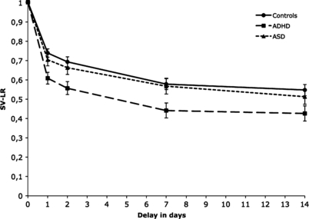
Attention deficit/hyperactivity disorder (ADHD)
Children with ADHD discount more than:
typically developing children
children with autism spectrum disorder (ASD)
Demurie et al., 2012
ADHD
ASD & Controls
Notes:
Attention deficit/hyperactivity disorder and autism spectrum disorder
SV-LR is subjective value of the large reward.

Slide 9

Development
There is an increase in delay discounting across childhood into early adolescence.
Discounting decreases across adolescence into adulthood.
Discounting peaks at 12-13 years old.
Steinberg et al 2009
Notes:
Psychologists have found that people tend to vary greatly in terms of their discount rates. Individual discount rates have been linked to a variety of personal characteristics, including the ones we just discussed. However, other factors can also influence discount rates. To demonstrate this, we’re going to do another activity

Slide 10
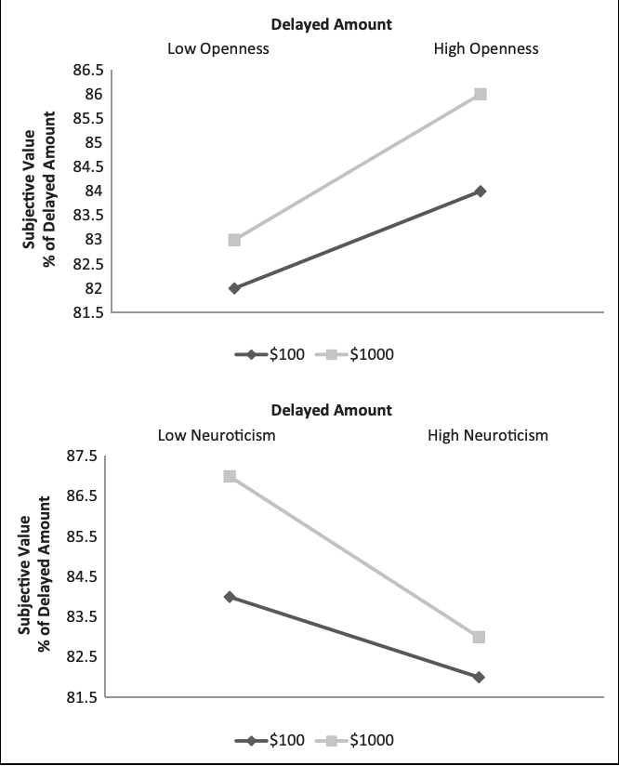
Personality
Greater delay discounting is associated with:
Low openness
Low conscientiousness
High extraversion
High neuroticism
Mahalingam et al 2014
Notes:
The graph is showing that there is greater discounting of higher value rewards for low openness and high neuroticism individuals. So, our guy with a high discount rate is more likely to be low on openeness and conscientiousness, high on extraversion and neuroticism.
Smaller amounts discounted more than larger amount - Amounts magnified effects of openness and neuroticism
The Big Five personality inventory (1) openness to new experience (artistic vs. conservative)
(2) Conscientiousness (self-controlled vs. easygoing)
(3) Extraversion (outgoing vs reserved)
(4) Agreeableness (compassionate vs. antagonistic)
(5) Neuroticism (emotionally unstable vs. stable)

Slide 11
Part 2
Access the short questionnaire and complete the test
Think about how much money you have right now. For each question, select the option that you’d rather have. Please choose as if you would actually either get the money tonight (if you choose the first option) or you’d actually get the money in the specified time (if you choose the second option)
You will only have 4 seconds to make your selection. The time remaining for your choice will be displayed on the screen. If you do not make your choice quickly enough you will have to begin the survey again.
https://tinyurl.com/y9usftyb
Notes:
Remind students to record their discounting score on the worksheet so that they can reference it later

Slide 12
Part 2
How did your score change under time pressure?
Notes:
Query about all types of changes (increase in discount rate, decrease in discount rate, no change in discount rate). Possibly even ask about the magnitude of change? (e.g. Did it change a bunch, or just a little?)
Resources (money, time), social factors
Psychologist have found that many external factors, like the ones we just discussed, can influence discount rates. Next, you’re going to either pick one these external factors, or think of one related to your own research or interests, and design an experiment to test whether or not it influences discount rates

Slide 13
Part 2 - Brainstorm
Think/Pair/Share - What contextual factors (experimental manipulations, environmental factors) may impact discounting/how?
Notes:
Query about all types of changes (increase in discount rate, decrease in discount rate, no change in discount rate). Possibly even ask about the magnitude of change? (e.g. Did it change a bunch, or just a little?)
Resources (money, time), social factors
Psychologist have found that many external factors, like the ones we just discussed, can influence discount rates. Next, you’re going to either pick one these external factors, or think of one related to your own research or interests, and design an experiment to test whether or not it influences discount rates

Slide 14
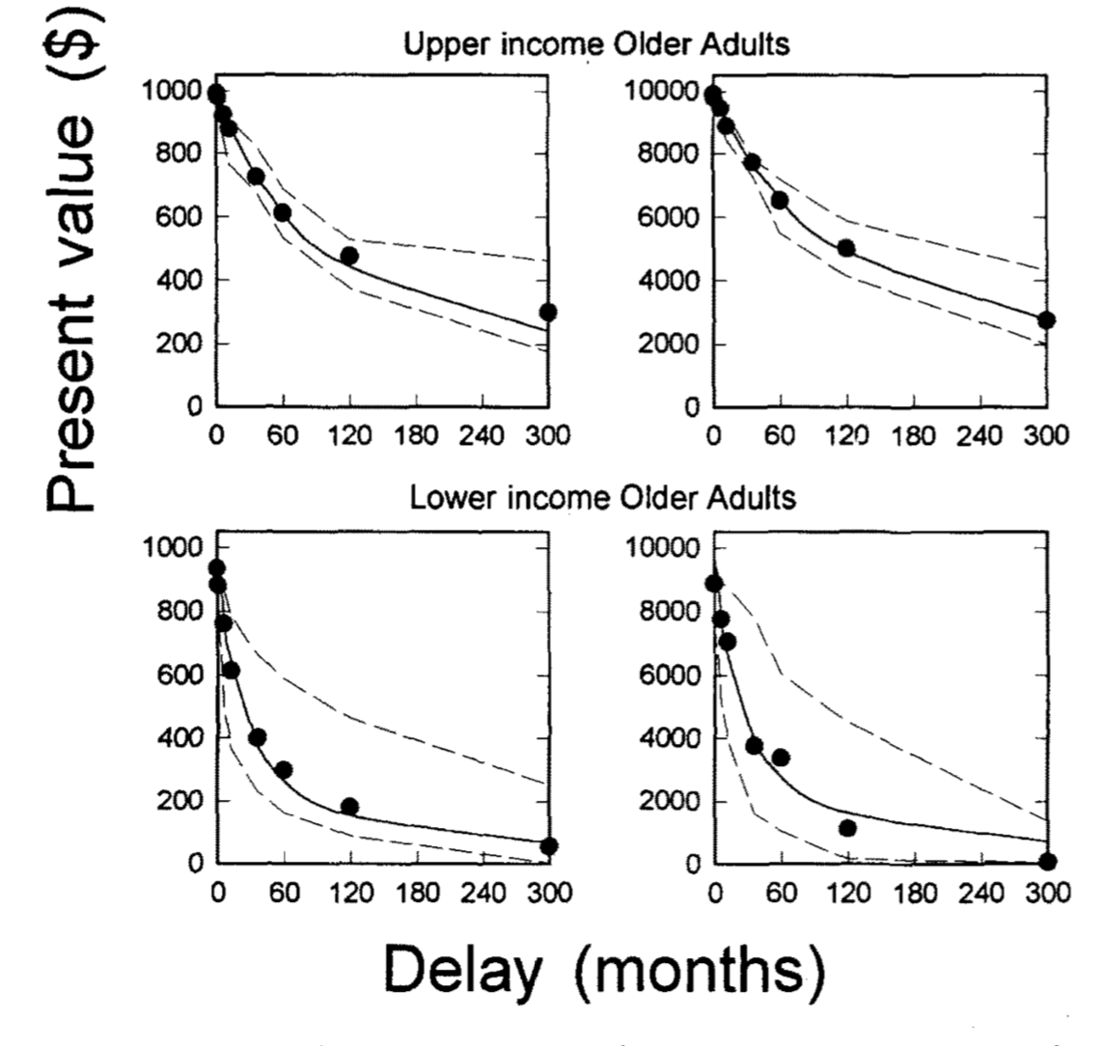
Socioeconomic status
$1,000
$10,000
Lower income older adults display greater discounting than upper income older adults.
High SES
Low SES
Green et al., 1996

Slide 15
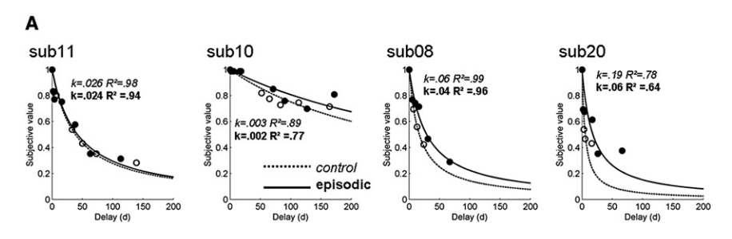
Episodic Future Thinking
Episodic future thinking reduces delay discounting.
Present
Oriented
Future Oriented
Peters & Büchel, 2010

Slide 16
Power
Power and monetary outcomes
Participants assigned to manager (high-power) or worker (low-power):
Manager assigned tasks to workers
Workers had no say in the tasks assigned to them.
Managers showed less delay discounting than workers on monetary discounting task.
Joshi & Fast, 2014
Workers
Mangers

Slide 17
Power
Power and non-monetary outcomes
Power priming conditions:
High power - Participants either wrote about a time when they had power
Low power - a situation in which they had no power
Neutral – a recent trip to the grocery store
Delay discounting task with reward of reduced air pollution.
Again, those in the high power condition showed less discounting
Joshi & Fast, 2014
Low Power
High Power
Notes:
“The County Department is considering a temporary change in its emission policy to study the effects of air quality on human health and local wildlife. In order to study the effects of air quality, the particulate output of nearby factories and power plants would be immediately reduced for a period of three weeks, after which time the air quality would return to its former level, but the government is also considering making the change 1 year in the future, for a different length of time.” # of days in the future: 21, 23, 25, 27, 29, 31, 33, or 35.

Slide 18
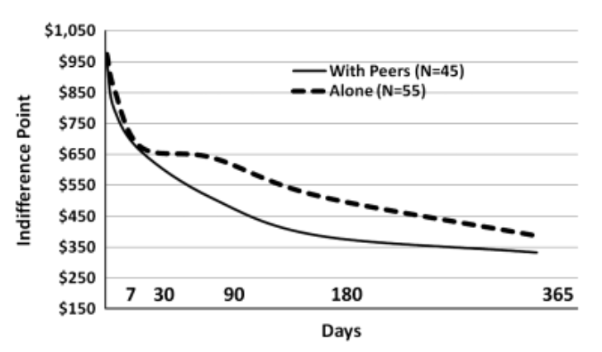
Peer pressure
Adolescents discount more in the presence of peers than when alone
O’Brien et al., 2011
With Peers
Alone

Slide 19
Power
Study 4: Sense of Power at work predicts real-life financial savings
Sense of Power scale
8 items (e.g., “I have a great deal of power at my place of work”); ratings were made on a 7-point scale (1 = strongly disagree, 7 = strongly agree; α = .90).
Total lifetime savings
Sense of Power at work predicted total lifetime savings.
Joshi & Fast, 2014

Slide 20
Part 3
Create an experiment to either:
Examine factors of interest to you that may impact delay discounting outcomes
OR
Examine how delay discount rate predicts some type of real-world behavior.
Outline a 1-minute presentation including:
Which option you are choosing (Option 1 or 2 from above)
The factor being manipulated (Option 1) or the factor thought to be predicted by delay discount rate (Option 2)
Your hypothesis

Slide 21
Learning Objectives
Broad
Understand variability in human decision making processes
Tangible
Describe delay discounting
Compare delay discounting under various conditions
Create an experiment to study delay discounting and predict expected outcomes

